Slide 1
STUDENT PORTFOLIO
STUDENT NAME : MOTHISHWARI V
REGISTER NO AND NM-ID : asanm225anm22524132251802522036
DEPARTMENT : BSC
COLLEGE : GOVERNMENT ARTS AND SCIENCE COLLEGE,VANUR.
THIRUCHITTRAMPALAM KOOTROAD .
[ANNAMALAI UNIVERSITY]

Slide 2
PROJECT TITLE
Creative student portfolio using FWD

Slide 3

AGENDA
1. Project Overview
2. End Users
3. Problem Statement
4. Tools and Technologies
5. Portfolio design and Layout
6. Features and Functionality
7. Results and Screenshots
8. Conclusion
9. Github Link

Slide 4
PROBLEM STATEMENT
This project solves the problem
by building a “web-based student
portfolio” that is easy to update,
visually appealing, and accessible online.

Slide 5

PROJECT OVERVIEW
Personal details (name, photo, contact)
Education background
Online learning
Career interests and goals

Slide 6
WHO ARE THE END USERS?
Students (who want to create their own portfolio)
Teachers/Professors (to review academic progress)
Recruiters / Employers (to evaluate skills and achievements)
Professionals (for networking and collaboration)
Self (Portfolio Owner – to present education & learning journey)

Slide 7

TOOLS AND TECHNIQUES
Frontend: HTML, CSS
Editor: Visual Studio Code
Version Control: Git & GitHub
Hosting: GitHub Pages

Slide 8
POTFOLIO DESIGN AND LAYOUT
Responsive and mobile-friendly design.
Clean sections with navigation (Education, Learning, Contact).
Attractive profile photo and About Me section.
Footer with email and GitHub link.

Slide 9
FEATURES AND FUNCTIONALITY
Responsive layout for all devices
Easy navigation through sections
Integration with GitHub link
Organized code structure

Slide 10
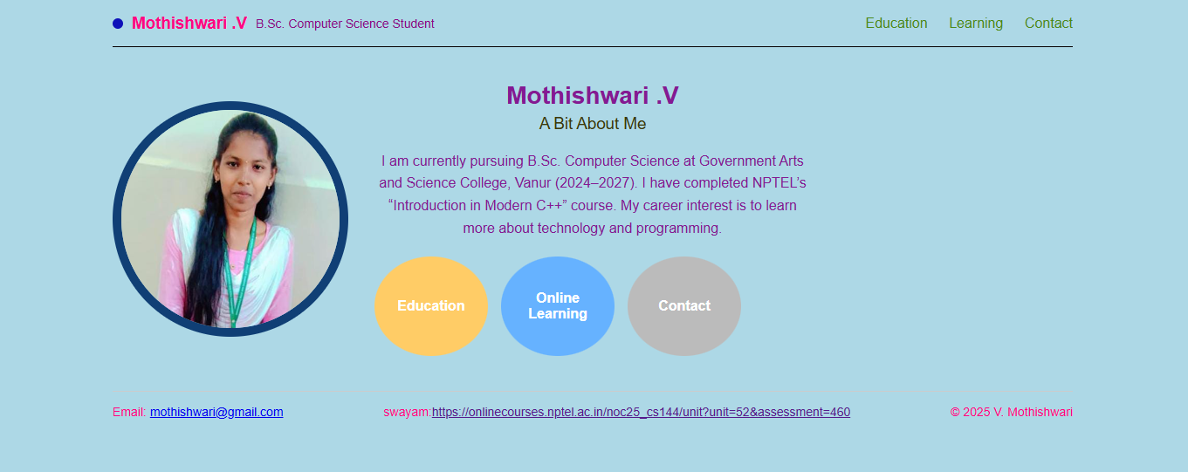

RESULTS AND SCREENSHOTS

Slide 11
GITHUB LINK
https://github.com/mothishwariv/student-portfolio

Slide 12
CONCLUSION
@ The Student Portfolio Website demonstrates web development skills” in HTML & CSS.
@ It also serves as a professional digital resume for future opportunities.

